Slide 1
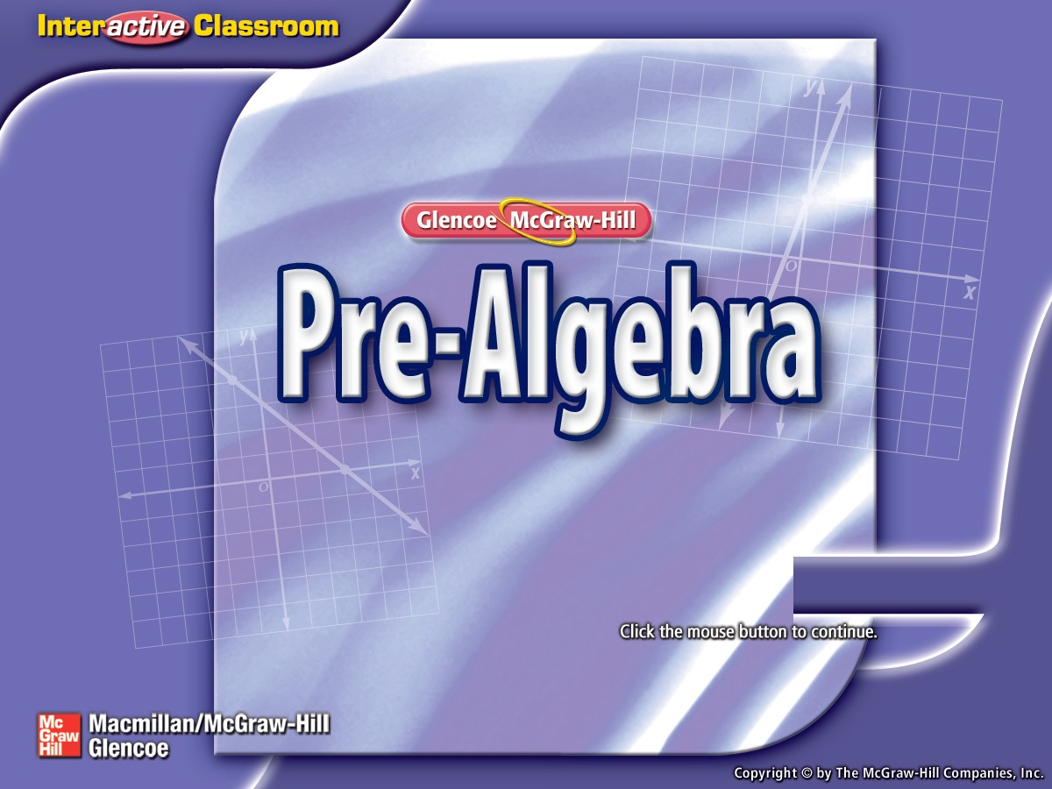


Splash Screen

Slide 2
Lesson Menu
Five-Minute Check (over Lesson 4–2)
Then/Now
New Vocabulary
Key Concept: Addition Property of Equality
Example 1: Solve Equations by Adding
Key Concept: Subtraction Property of Equality
Example 2: Solve by Subtracting
Example 3: Real-World Example: Solve by Subtracting

Slide 3

5-Minute Check 1
Which gives a correct listing for the expression
4q + 5p – 9 – p + 8q?
terms: 4q, 5p, –p, 8q
like terms: 4q, 5p
constants: 9
coefficients: 4, 5, –1, 8,

Slide 4

5-Minute Check 2
Simplify the expression 4m + 6m + 3.
A. 13 + m
B. 13m
C. 10m + 3
D. 10m

Slide 5

5-Minute Check 3
Simplify the expression 24a – a + 16.
A. 25a + 16
B. 23a + 16
C. 24a² + 16
D. 40

Slide 6

5-Minute Check 4
Simplify the expression 9(r + 7) – 12r.
A. –21r + 7
B. –11r + 63
C. –3r + 63
D. –3r + 7

Slide 7

5-Minute Check 5
Simplify the expression 6(x – 2) + 8x.
A. 14x – 12
B. 14x – 2
C. 14x
D. 10x

Slide 8

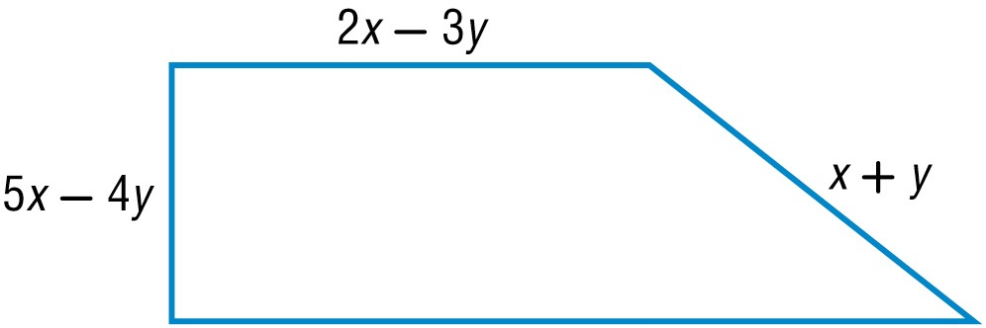
5-Minute Check 6
The perimeter of the trapezoid below is 11x – 8y. Write an expression for the measure of the fourth side of the figure.
A. 8x – 6y
B. 2x
C. 3x – 2y
D. 5x – 6y

Slide 9


Then/Now
You have already worked with the additive inverse of a number when you subtracted integers. (Lesson 2–3)
Solve equations by using the Addition and Subtraction Properties of Equality.
Translate verbal sentences into equations.

Slide 10

Vocabulary
equation
solution
solving the equation
inverse operation
equivalent equation

Slide 11
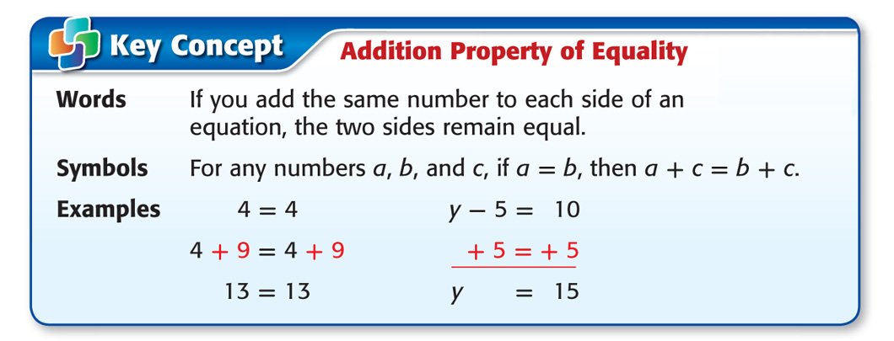
Concept A

Slide 12
Example 1A
Solve Equations by Adding
A. Solve x – 4 = –3. Check your solution and graph it on a number line.
x – 4 = –3 Write the equation.
+ 4 = + 4 Addition Property of Equality
x + 0 = 1 Additive Inverse Property
x = 1 Identity Property

Slide 13

Example 1A
Solve Equations by Adding
To check that 1 is the solution, replace x with 1 in the original equation.
Check x – 4 = –3 Write the equation.
?
1 – 4 = –3 Check to see if the sentence
is true.
–3 = –3 The sentence is true.
✓
Answer: The solution is 1. Draw a dot at 1 on the number line.

Slide 14

Example 1B
Solve Equations by Adding
B. Solve –8.4 = n – 6.1. Check your solution and graph it on a number line.
–8.4 = n – 6.1 Write the equation.
+ 6.1 = + 6.1 Addition Property of Equality
–2.3 = n + 0 Additive Inverse Property
–2.3 = n Identity Property
Answer: The solution is –2.3. Draw a dot at –2.3 on the number line.

Slide 15






Example 1A
A. Solve x – 7 = –3. Graph the solution on a number line.
A. x = 10;
B. x = –10;
C. x = 4;
D. x = –4;

Slide 16




Example 1B
B. Solve –7.1 = m – 3.8. Graph the solution on a number line.
A. x = 10.9;
B. x = –10.9;
C. x = 3.3;
D. x = –3.3;

Slide 17

Concept B

Slide 18
Example 2A
Solve by Subtracting
A. Solve 32 = y + 12. Check your solution.
32 = y + 12 Write the equation.
–12 = –12 Subtraction Property of
Equality
20 = y Additive Inverse and Identity
Properties
Answer: The solution is 20.

Slide 19
Example 2A
Solve by Subtracting
Check 32 = y + 12 Write the equation.
?
32 = 20 + 12 Check to see if the
equation is true.
✓
32 = 32 The sentence is true.

Slide 20
Example 2B
Solve by Subtracting
B. Solve x + 6.9 = 4.2. Check your solution.
x + 6.9 = 4.2 Write the equation.
–6.9 = –6.9 Subtraction Property of
Equality
x = –2.7 Additive Inverse and Identity
Properties
Answer: The solution is –2.7.

Slide 21
Example 2B
Solve by Subtracting
Check x + 6.9 = 4.2 Write the equation.
?
–2.7 + 6.9 = 4.2 Check to see if the
equation is true.
✓
4.2 = 4.2 The sentence is true.

Slide 22
Example 2A
A. Solve 14 = t + 5.
A. –19
B. –9
C. 9
D. 19

Slide 23
Example 2B
B. Solve r + 4.8 = 1.5.
A. –6.3
B. –3.3
C. 3.3
D. 6.3

Slide 24
Example 3
Solve by Subtracting
MOUNTAINS Driskill Mountain, with a height of
535 feet, is the highest point in Louisiana. It is
8214 feet lower than Guadalupe Peak, which is the highest point in Texas. Write and solve a subtraction equation to find the height of Guadalupe Peak.
Let h = the height of Guadalupe Peak.
535 = h – 8214 Write the equation.
535 + 8214 = h – 8214 + 8214 Add 8214 to each side.
8749 = h Simplify.
Answer: Guadalupe Peak is 8749 feet high.

Slide 25
Example 3
BUILDINGS Write and solve an equation to find the expected height of the Freedom Tower, which is being built at the World Trade Center site in New York City. The Sears Tower in Chicago is 1450 feet tall, which is 326 feet lower than the expected height of the Freedom Tower.
1450 = h + 326; 1124 feet
h = 1450 – 326; 1124 feet
1450 = h – 326; 1776 feet
1450 – h = 326; 1776 feet

Slide 26
End of the Lesson

